Slide 1
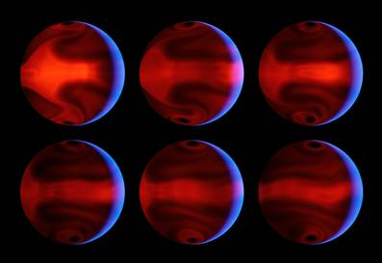
Lecture 9:
More About Extrasolar Planets
Please remind me to take a break at 12:45 pm!
Predicted weather patterns on HD80606
Claire Max
May 1, 2014
Astro 18: Planets and Planetary Systems
UC Santa Cruz
Page

Slide 2
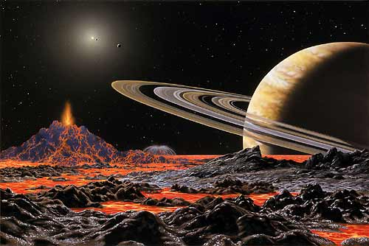
Outline of lecture
Formation of protoplanetary disks
Orbits and masses of exoplanets
Planet formation in the light of what we know about exoplanets today
Atmospheres of exoplanets
Future exoplanet detection plans
Page

Slide 3
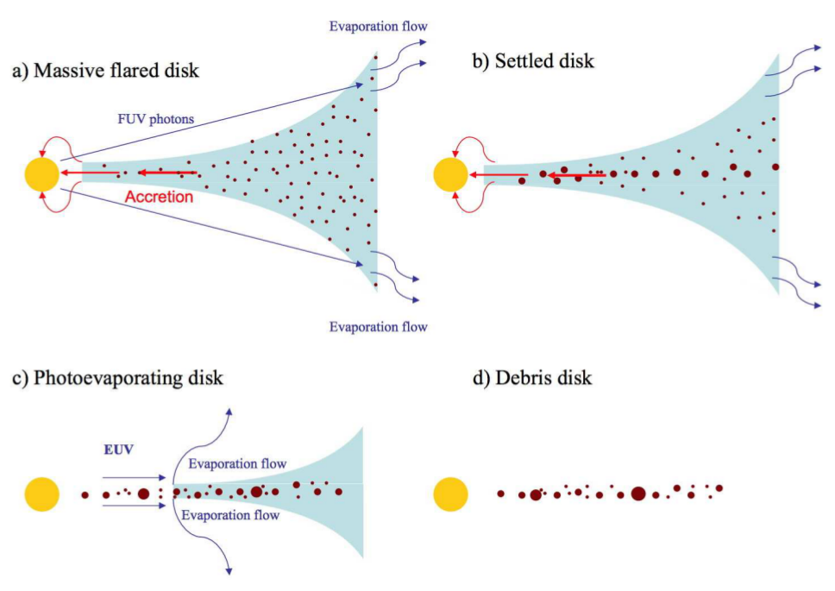
Phases in the evolution of protplanetary disks: theory
Credit: Jonathan Williams and Lucas Cieza
Page

Slide 4
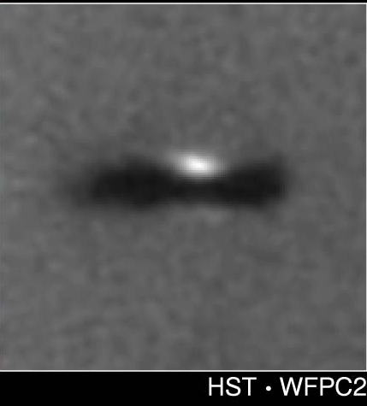
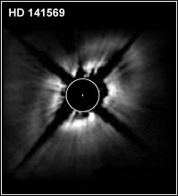
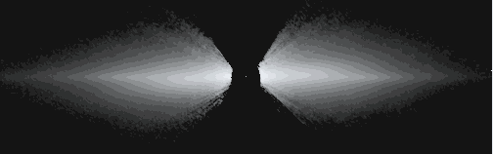
Phases in the evolution of protplanetary disks: data
Young protoplanetary disks: lots of dust and gas. Opaque. Planets and low-mass stars within disk can create features.
1 Myr
5 Myr
Transitional disks: much less dust and gas. No longer opaque.
Old disks: dust is replenished by collisions of rocky bodies.
Very little gas.
12-20
Myr
Beta Pictoris disk

Slide 5
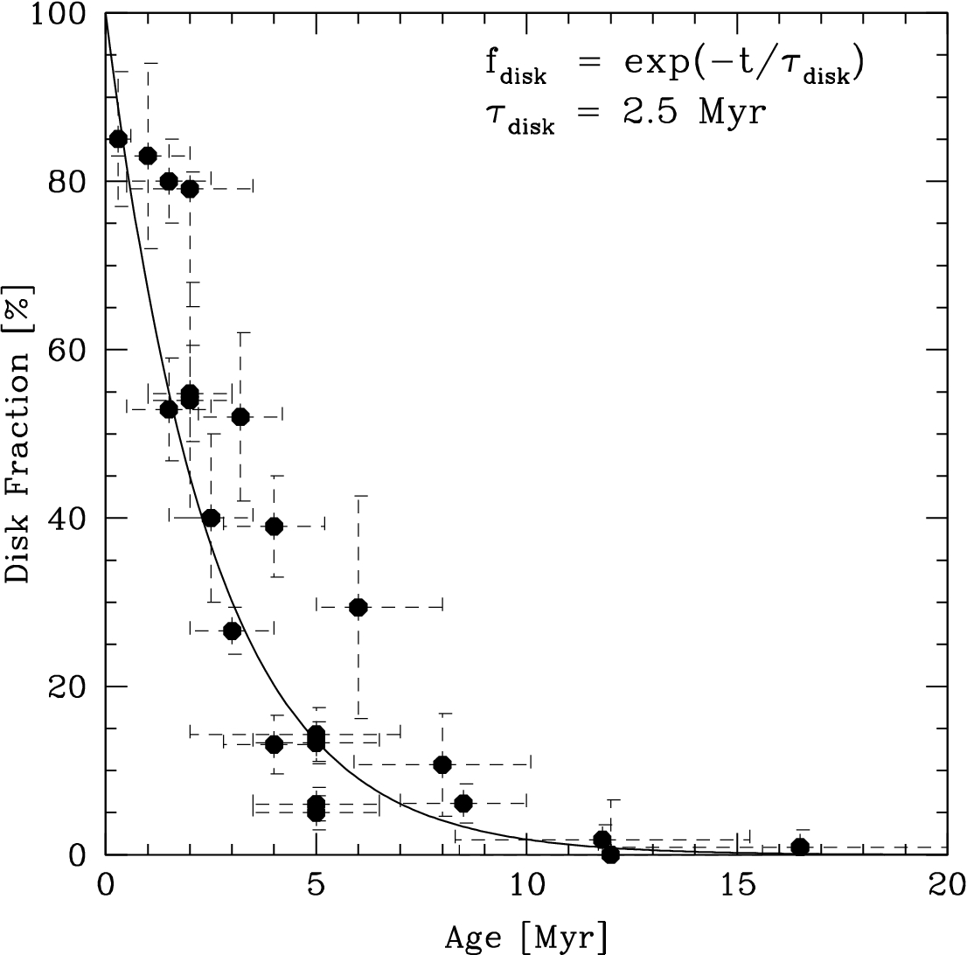
Protoplanetary disks have short lifetimes: a few million years
This means that giant planet formation must be very fast.
Giant planets must accumulate tens to hundreds of Earth masses of nebular gas, before gas is lost from the disk.
Slide credit: Jonathan Fortney

Slide 6
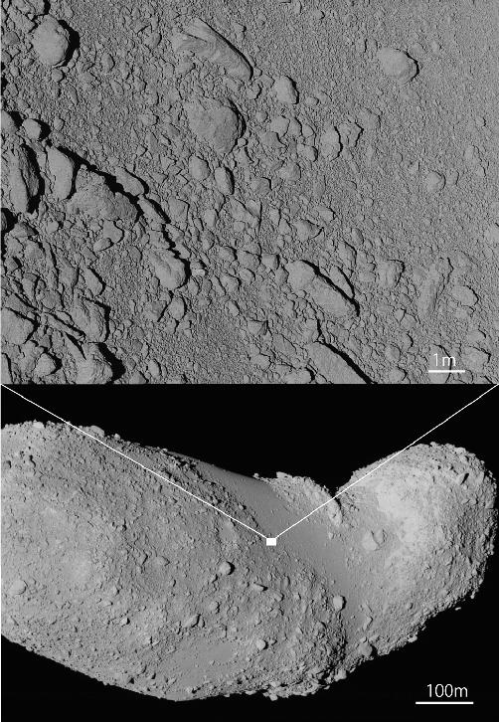
Core accretion: dust grains + pebbles stuck together to form larger bodies
Asteroid Itokawa in our own Solar System may be a close-up example
Called a “rubble pile”
Self gravity not large enough to make it round

Slide 7
Unanticipated characteristics of extra-solar planets
Much higher eccentricity in most of their orbits
Much higher fraction of planets very close to their parent stars.
Many of these have masses comparable to Jupiter’s.
Many planets are “super-Jupiters” (up to 10 times more massive than Jupiter)
Page

Slide 8
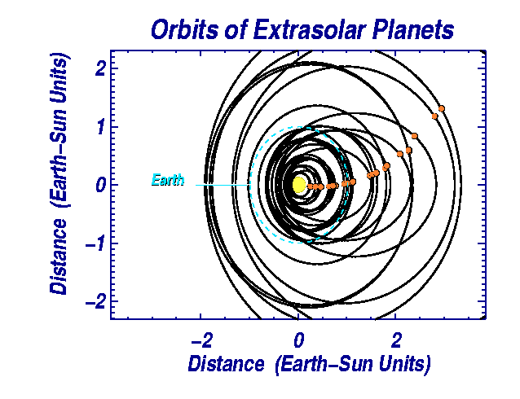
Eccentric Orbits
Page

Slide 9
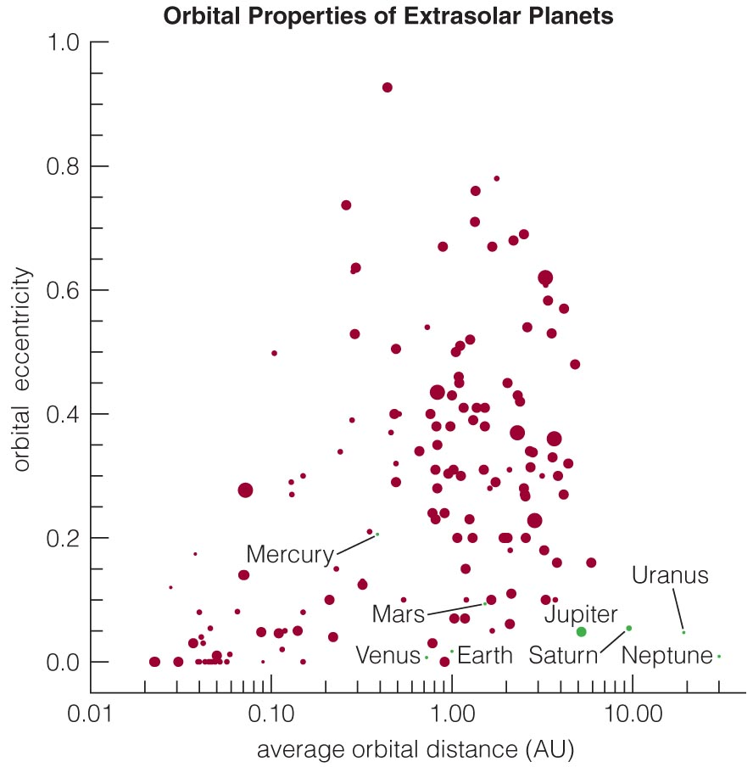
Eccentric Orbits
Orbits of some extrasolar planets are much more elongated (have a greater eccentricity) than those in our solar system.

Slide 10
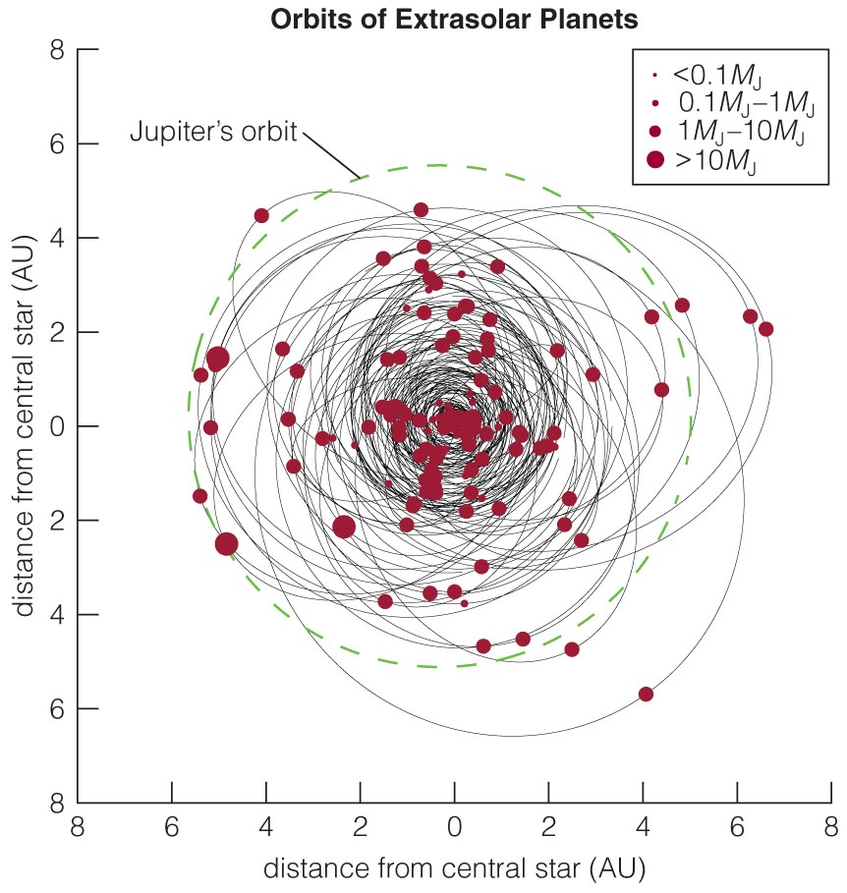
Eccentric Orbits
A significant number of the detected planets have orbits smaller than Jupiter’s.
But note that planets at greater distances are harder to detect with the Doppler and transit techniques.

Slide 11
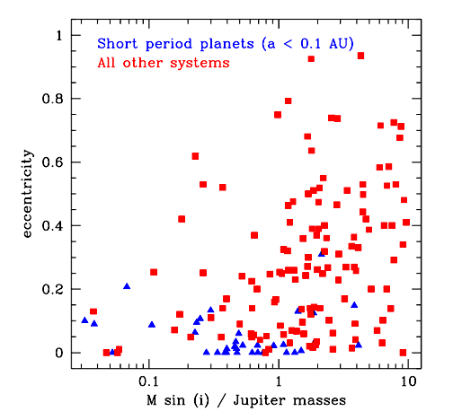
The shortest period exoplanets have orbits close to circular
Short period planets:
  Very close to parent stars, very low eccentricity
  Same process that moved planets close to star circularized their orbits
Page

Slide 12
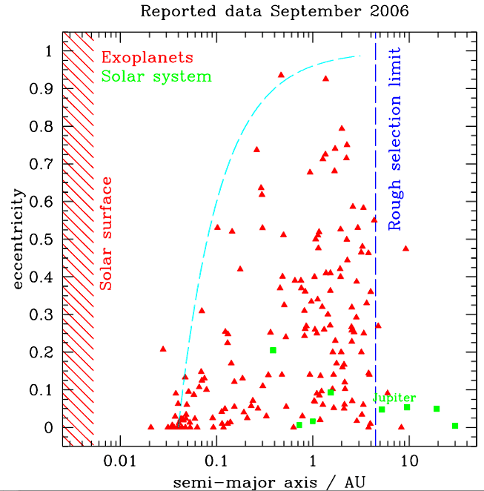
Many extrasolar planets are very close to parent stars
Much of this is a selection effect
  Radial velocity and transit methods more sensitive to planets close to parent stars
Nevertheless, there are many more close-in exoplanets than were expected
Our Solar System is very different (green points)
Page
Notes:
Selection effect: external factors that prevent them to be seen. Many reasons:
1) small wobble because planet is either far or small in mass
2) we need to observe at least one full orbit of a planet to confirm it. But Jupiter-like planet take 12 years to complete one orbit!
3) Planetary transits: if planet orbit is slightly inclined to line of sight, close-in planets will still transit parent star whereas more distant planets won’t

Slide 13
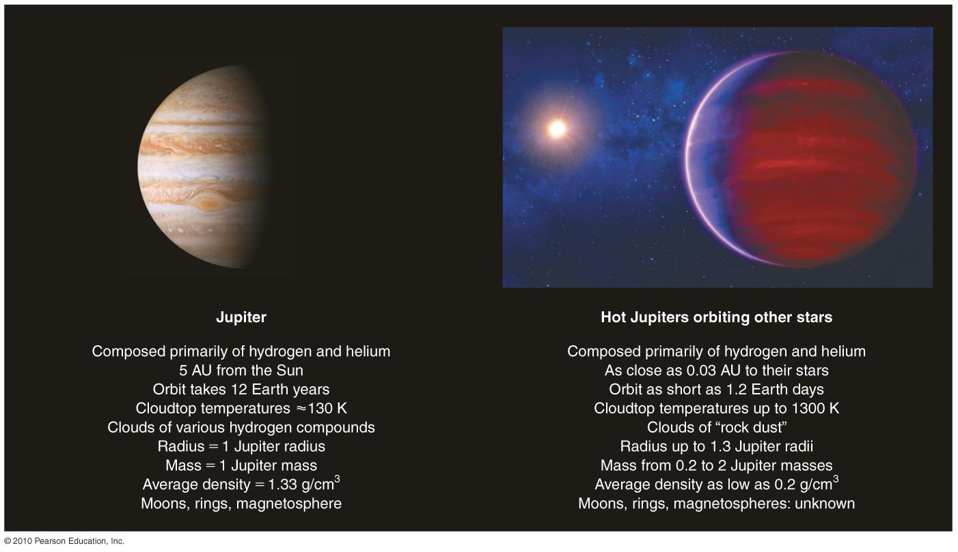
Hot Jupiters: very close to parent stars

Slide 14
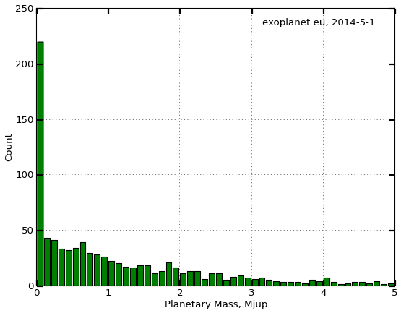
Characteristics of Extra-Solar Planets: Mass
Starting to see Neptunes and terrestrial planets
Significant number of planets much more massive than Jupiter
Page

Slide 15
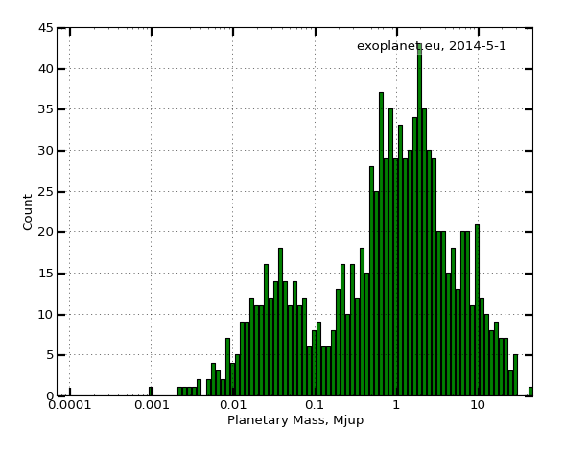
Characteristics of Extra-Solar Planets: Mass
Jupiters and
Super-Jupiters
Neptunes
Terrestrial
planets
Page

Slide 16
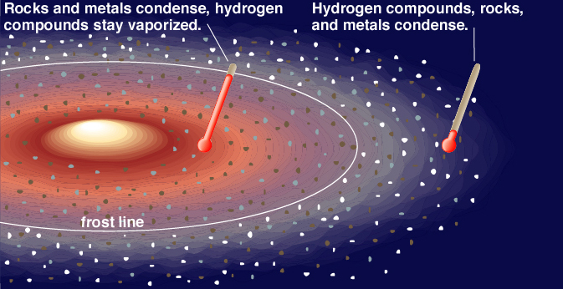
Role of the “frost line” or “ice line”
Our Solar System has small rocky planets close to star, large gas giants further away
  no experience of large massive planets close to sun in our Solar System
Theory of giant planet formation says they have to form outside “frost line”
Page

Slide 17
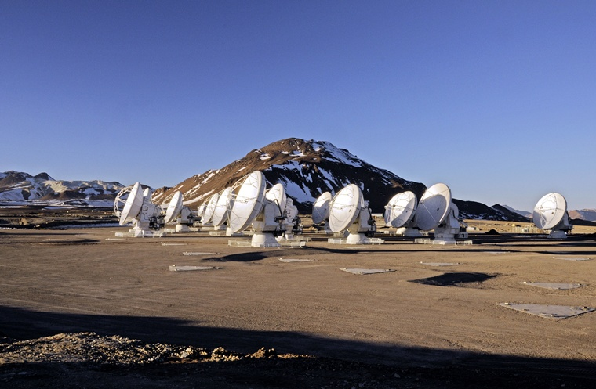
New evidence that the “ice line” is real in other solar systems
Disk around young star TW Hydra
Observed at brand new Atacama Large Millimeter Array (ALMA) by Qi and colleagues
Page

Slide 18
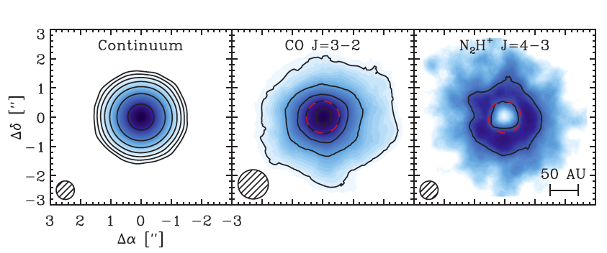
New evidence that the “ice line” is real in other solar systems
Disk around young star TW Hydra
Observed at brand new Atacama Large Millimeter Array (ALMA) by Qi and colleagues
Red dashed line shows position of “ice line” of CO
Page

Slide 19
How are giant extrasolar planets formed?
Theory for our Solar System:
  Stellar wind from young Sun blew volatiles outwards
  “Snowstorm” at 5 AU where water-ice solidified
  Fast accretion of large icy planet (~10 M_{Earth}) which then collected H/He atmosphere
    Gas giants Jupiter, Saturn just outside “frost line”
    Small rocky planets inside
    Slowly accreting icy planets in outer system (Uranus, Neptune)
Extrasolar giant planets:
Do they form in situ?
looks impossible: too hot for ices, too little material for rock
Do they form outside frost line and migrate inwards?
planet forms in gas/dust disc around star
drag from remaining gas/dust causes it to spiral inwards
or scattering from other giant planets causes migration
why does it stop?
Page

Slide 20
This is the “paradigm shift”
Original theories of solar system formation developed when our own Solar System was the only one
  Mostly circular orbits
  Giant planets in outer solar system, terrestrial planets inside
New Solar Systems are (in general) not like ours
Needs a new theory
How to arrive at a new paradigm?
  Mostly use computer simulations to develop ideas, test hypotheses, make predictions
  Test predictions against observed young solar systems, disks
Page

Slide 21
Theories for how giant planets got so close to their stars
Interactions between individual new planets and gaseous disk. “Migration”
After gas disk cleared away, several giant planets in outer parts of solar system were left
  Three-body gravitational interactions between them
  One giant planet got slung outwards, a second was slung inwards and got “captured” by the star in a close orbit
  But why isn’t the close orbit very elliptical?
Why didn’t our own Jupiter migrate inwards close to Sun?
Page

Slide 22
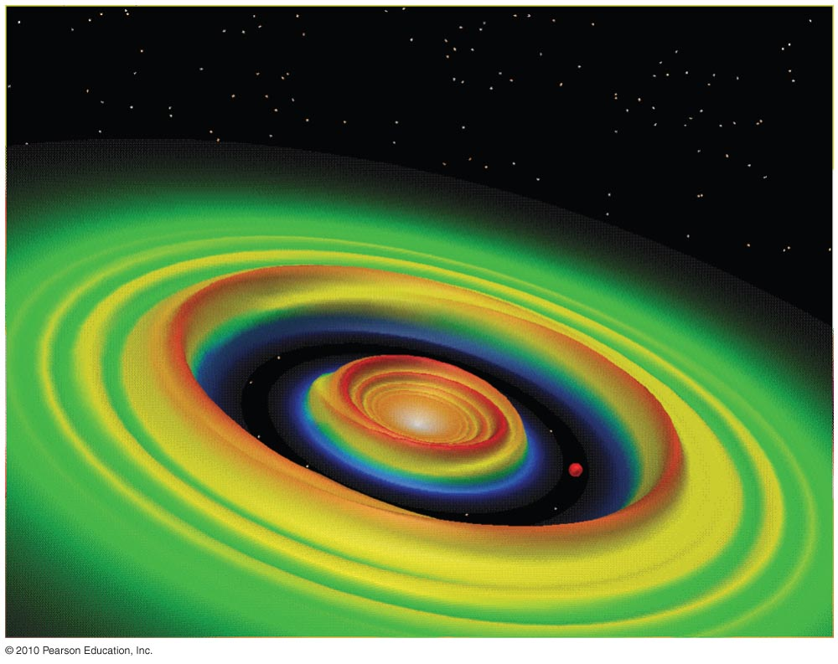
Planetary Migration in a massive disk
A young planet’s motion can create waves in a planet-forming disk.
Models show that matter in these waves can tug on a planet, causing its orbit to migrate inward.

Slide 23
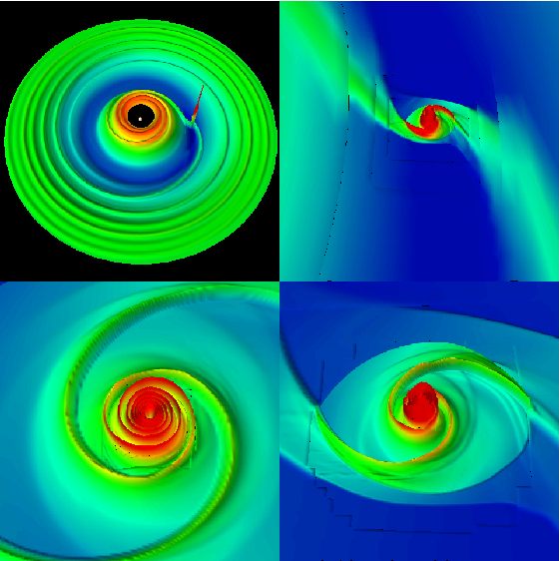
1. Planet formation in gaseous disk
One planet in a gaseous disk
Accretion begins, gap starts to form
Planet can continue to accrete mass even after a “gap” in disk has formed
From computer simulation by Pawel Ciecielag
Page

Slide 24
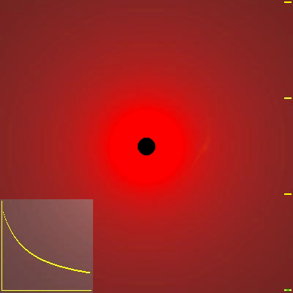
Computer simulation by Armitage
Formation of planet and gap within a protostellar disk
Planet can continue to accrete mass even after a “gap” in disk has formed
As a result of the interaction with the disk, the planet moves in
Philip Armitage
Page

Slide 25
YouTube videos: planet migration
https://www.youtube.com/watch?v=ko52m9jJGTQ
https://www.youtube.com/watch?v=nwSNU3-m0ew

Slide 26
Hypothesis 2:
Gravitational Encounters
Close gravitational encounters between two or three massive planets can eject one planet while flinging the other((s) into a highly elliptical orbit.
Multiple close encounters with smaller planetesimals can also cause inward migration.

Slide 27
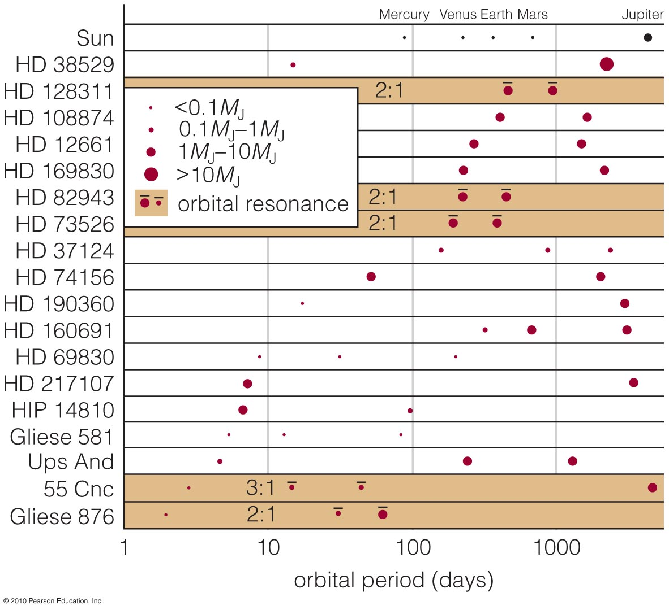
Orbital Resonances
Resonances between planets can also cause their orbits to become more elliptical.

Slide 28
Thought Question
What happens in a gravitational encounter that allows a planet’s orbit to move inward?
It transfers energy and angular momentum to another object.
The gravity of the other object forces the planet to move inward.
It gains mass from the other object, causing its gravitational pull to become stronger.
Notes:
Rocky material condensed everywhere.
B. The students often get confused by the differentiation ideas they’ve just
heard about in planet formation.
D. If a passing star ripped off asteroids, it would have stripped away comets
and planets too. (That may be one explanation for the truncation of the
Kuiper belt…)

Slide 29
Thought Question
What happens in a gravitational encounter that allows a planet’s orbit to move inward?
It transfers energy and angular momentum to another object.
The gravity of the other object forces the planet to move inward.
It gains mass from the other object, causing its gravitational pull to become stronger.
Notes:
Rocky material condensed everywhere.
B. The students often get confused by the differentiation ideas they’ve just
heard about in planet formation.
D. If a passing star ripped off asteroids, it would have stripped away comets
and planets too. (That may be one explanation for the truncation of the
Kuiper belt…)

Slide 30
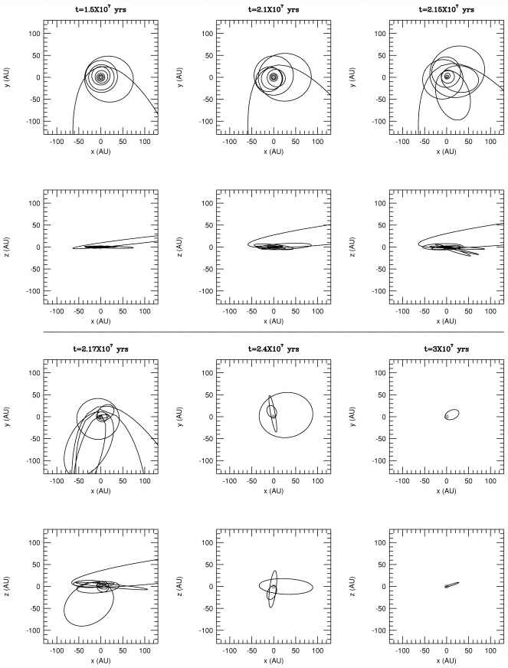
Hypothesis 2: Multi-Planet Interactions as Cause of Planetary Migration
Simulation: start with 100 Planet “Embryos”
Scatter, Collide, Stick, Accrete Gas
After 21.5 Myr:
Chaos
After 30 Myr:
Lone Close-in
Jupiter in
Eccentric Orbit.
Page

Slide 31
What have we learned?
Can we explain the surprising orbits of many extrasolar planets?
  Original nebular theory cannot account for the existence of hot Jupiters.
  Planetary migration or gravitational encounters may explain how Jupiter-like planets moved inward.
Can we explain large eccentricities of exoplanets?
  Migration and encounters may play a larger role than previously thought.

Slide 32
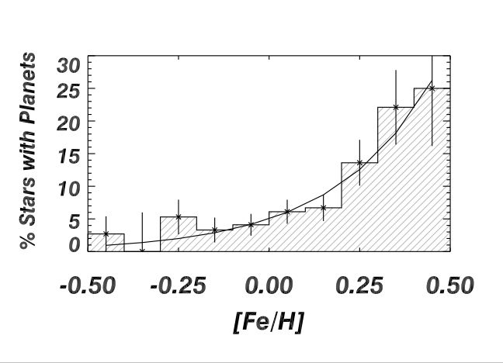
Parent stars of extrasolar planets
High in elements heavier than hydrogen and helium
Reasonable: planets
form from dust, which is made of elements heavier than hydrogen and helium
Probability of finding a planet increases as heavy element content of parent star increases
P_{planet} ~ (N_{Fe}/ N_{H})^{1.6}
Page

Slide 33
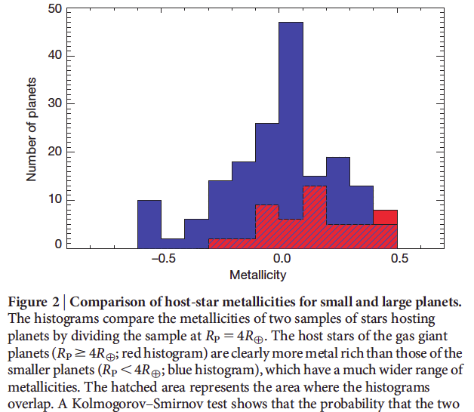
Gas giant planets prefer stars with high metallicity
Gas giant planets
Smaller planets
Smaller planets seem to form around stars with a wider range of metallicity
Credit: Buchhave, Nature article

Slide 34
Atmospheres of exoplanets:
How do we learn about them?
Transit method: subtract spectrum of star from spectrum of star plus planet, to see spectrum of planet alone
Direct imaging method: take spectrum of planet directly, since it is spatially separated from the parent star

Slide 35
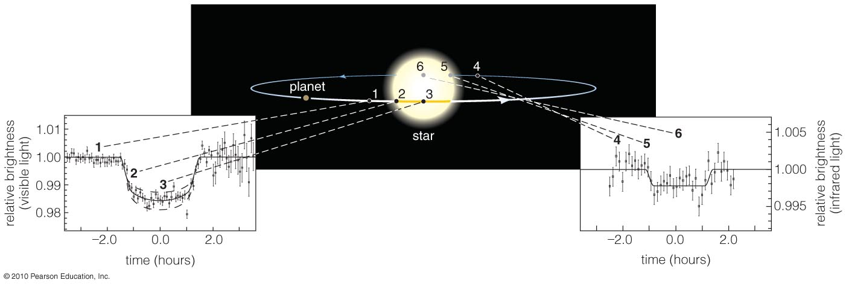

Transits and Eclipses
Transit: when a planet crosses in front of a star.
Eclipse: when star passes between us and the planet
No orbital tilt: accurate measurement of planet mass (planet wouldn’t transit at all if orbit were tilted)

Slide 36
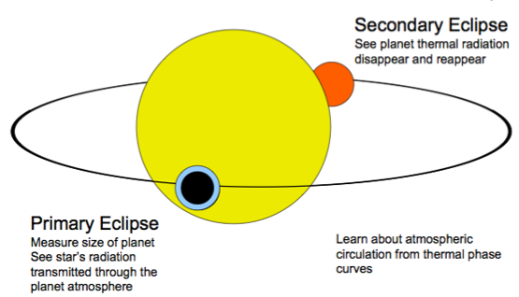
Seager & Deming, Annual Reviews of Astronomy & Astrophysics (September 2010)

Slide 37
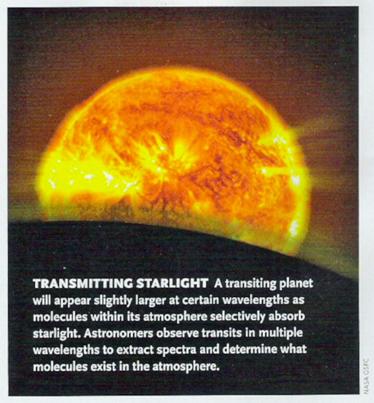
Credit: Jonathan Fortney, Sky and Telescope Magazine

Slide 38
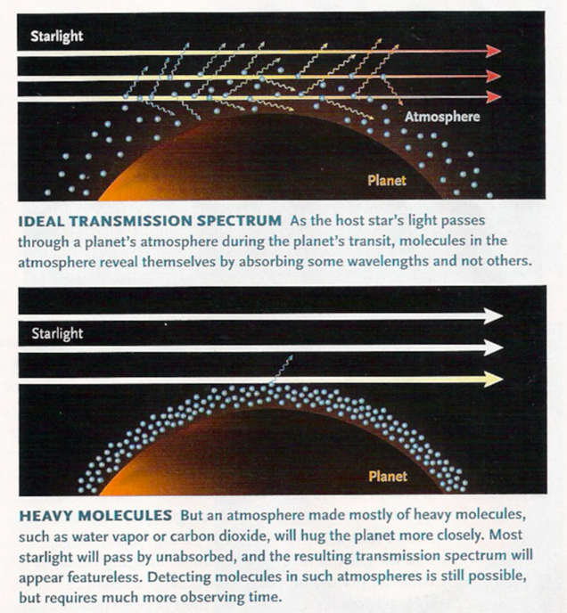
Credit: Jonathan Fortney, Sky and Telescope Magazine

Slide 39
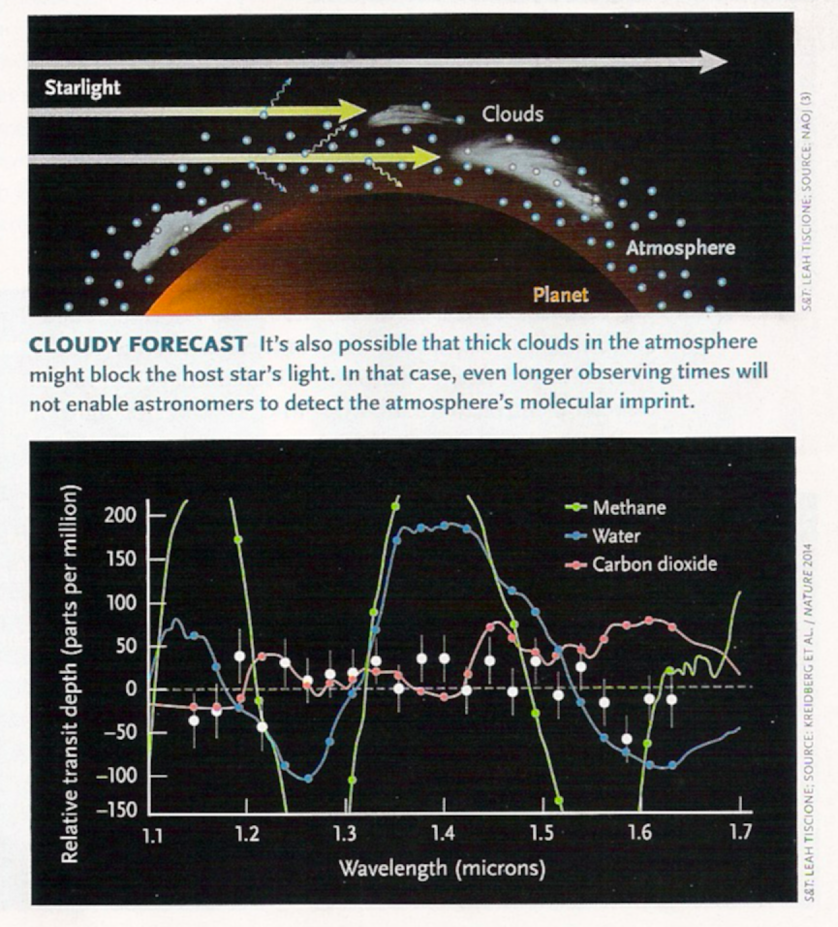
Credit: Jonathan Fortney, Sky and Telescope Magazine

Slide 40
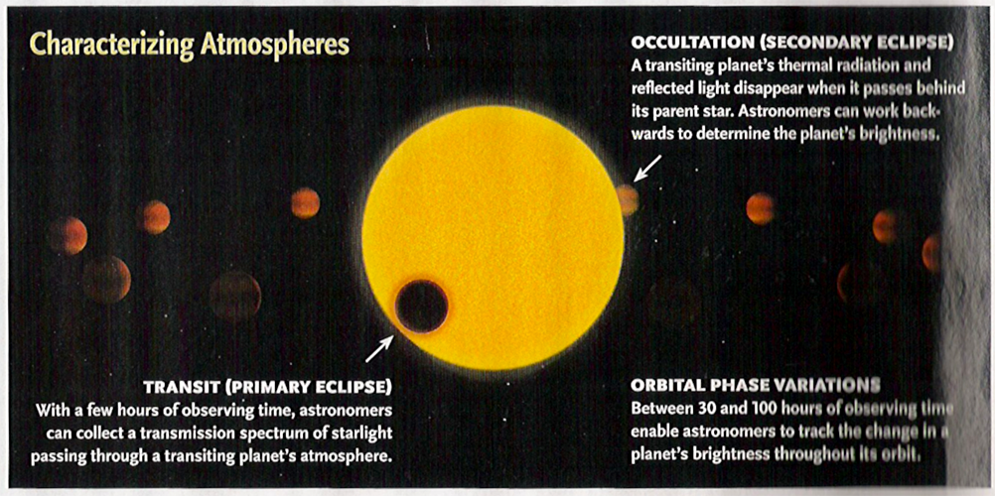
Credit: Jonathan Fortney, Sky and Telescope Magazine

Slide 41
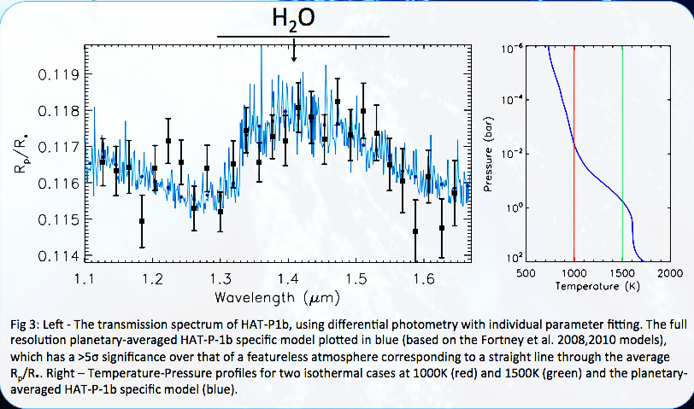
Water in the spectrum of planet Hat-p-1b
Credit: Wakeford, 2013

Slide 42
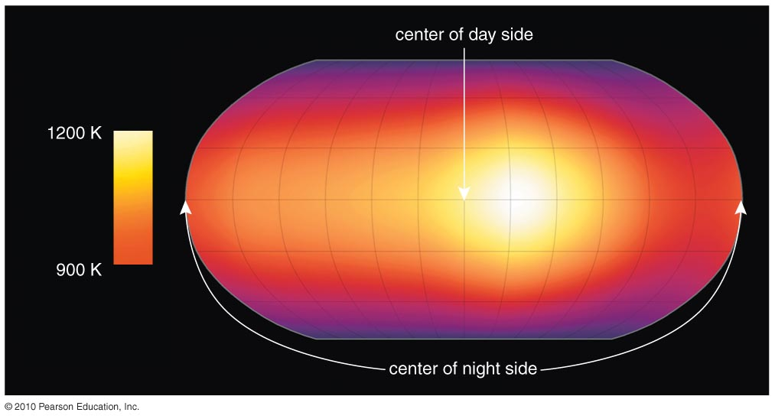
Surface Temperature Map
Measuring the change in infrared brightness during an eclipse enables us to map a planet’s surface temperature.

Slide 43
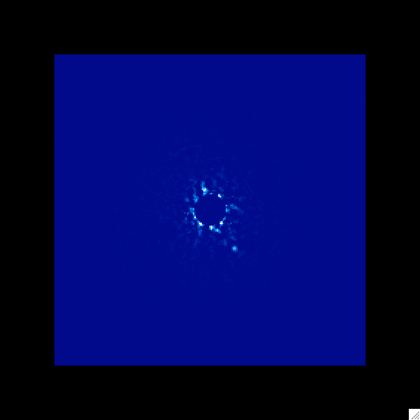
Beta Pictoris b spectrum, Gemini Planet Imager (direct imaging with adaptive optics)
Model T=1600K log(g)=5
Massive planet
Credit: GPI Team

Slide 44
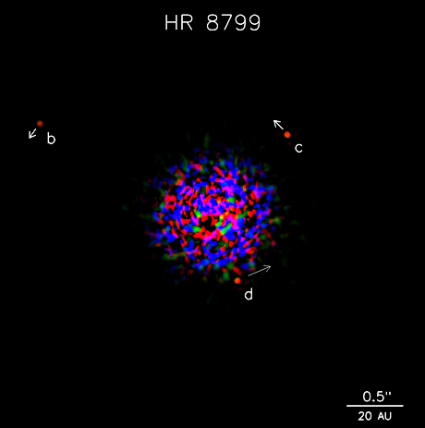
First Images of Exoplanets:
HR 8799 Solar System
Marois et al. 2008, Science Magazine
Page

Slide 46
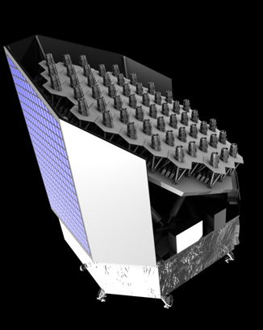
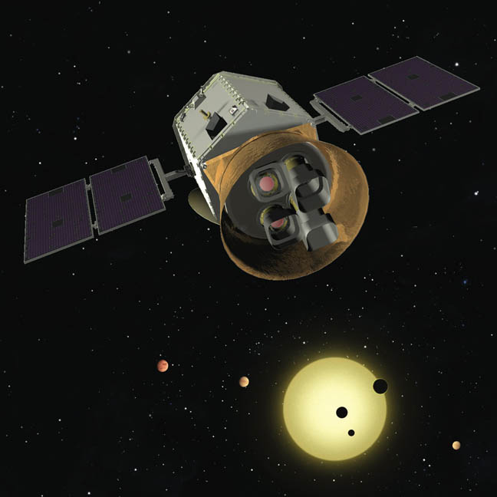
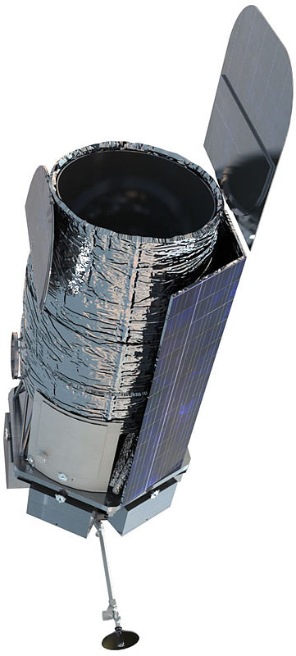
Future ambitious space missions to detect Earth-like planets
TESS:
NASA
PLATO:
European
Space Agency
WFIRST:
NASA
Page

Slide 47
Ambitious space mission: giant starshade
James Webb Space Telescope (2018 launch)
Giant starshade free-floating in space

